Slide 1
Southwest Collaboration
Community Based Faculty Survey

Slide 2
Sent to ~1,000 Mercy & Cox physicians 393 surveys started 325 completed every question
Degree

Slide 3
Specialty
Core Clerkships | % | Count
Family Medicine | 25.95% | 96
Internal Medicine/Hospitalist | 10.54% | 39
Child Health | 5.95% | 22
General Surgery | 4.59% | 17
Surgery Specialties | 8.38% | 31
OB/GYN | 4.32% | 16
Neurology | 1.08% | 4
Psychiatry | 1.08% | 4
Other | 38.11% | 141
Total |  | 370

Slide 4
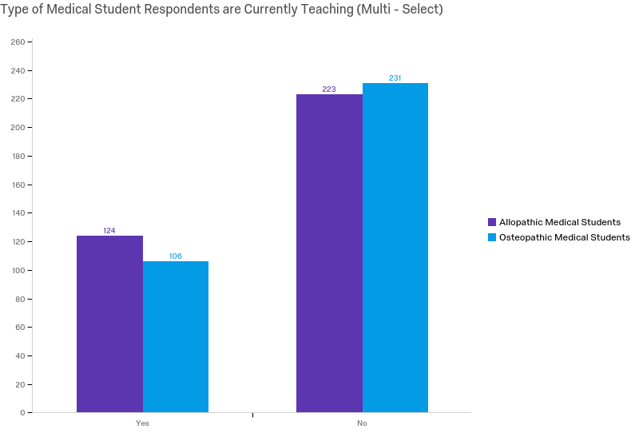

Slide 5
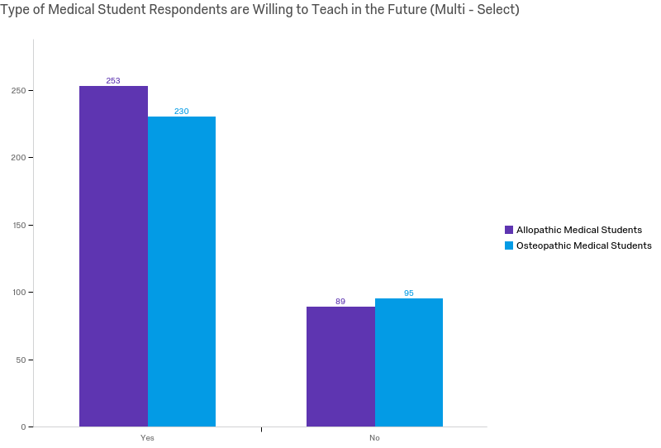

Slide 6
103 Respondents indicated not currently teaching, but willing to teach in the future
31 of the 103 would like additional information regarding teaching opportunities

Slide 7
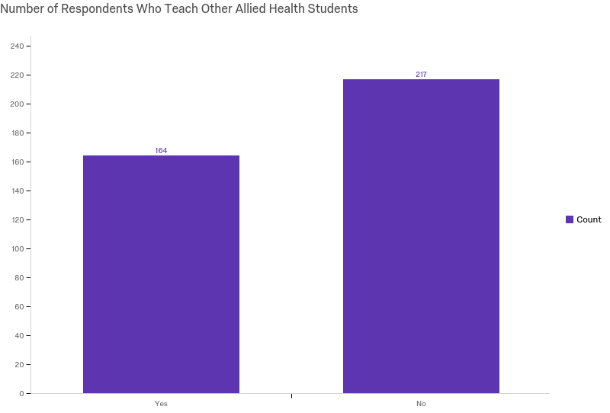

Slide 8
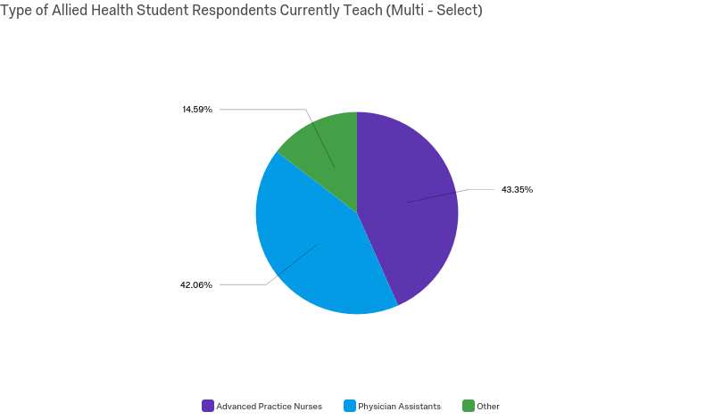

Slide 9
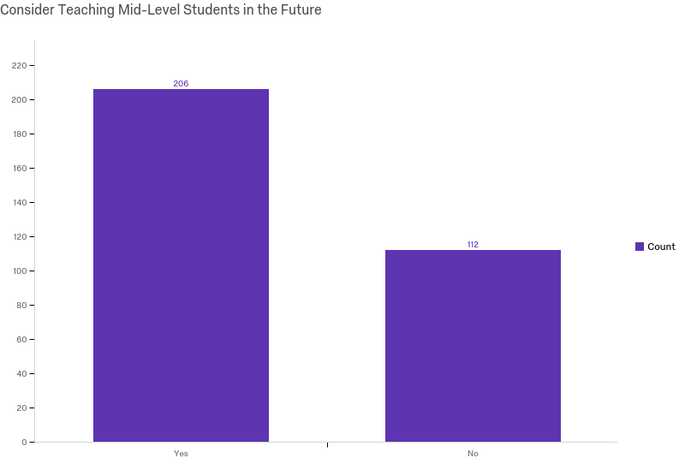

Slide 10
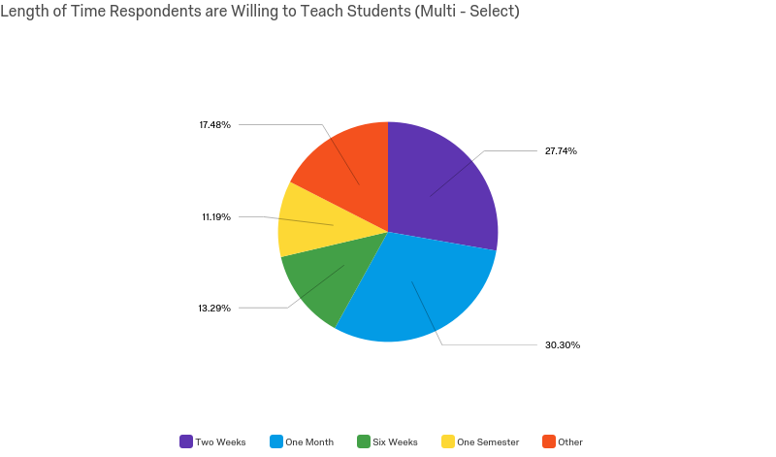

Slide 11
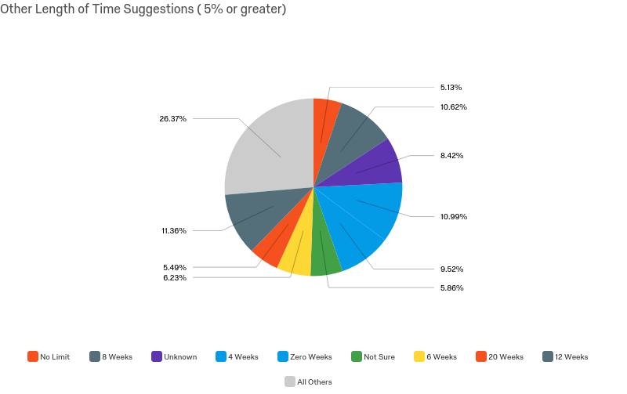

Slide 12
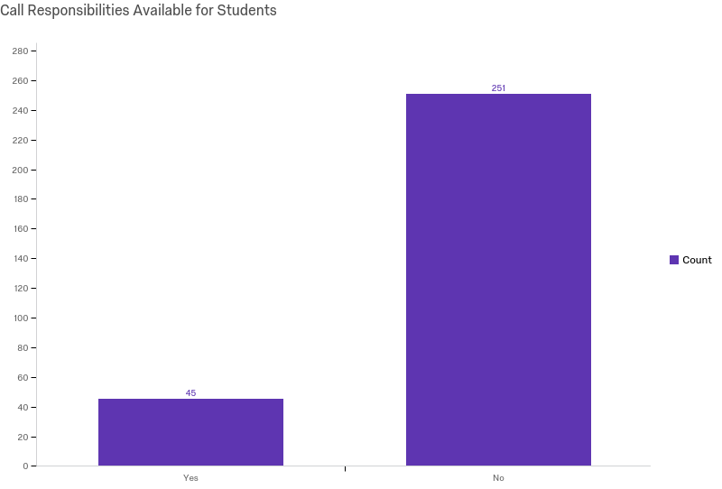

Slide 13
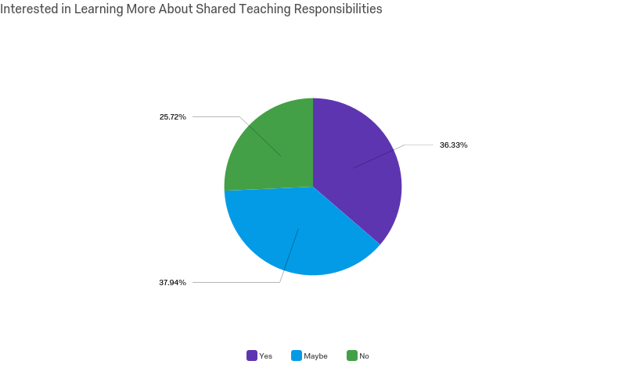

Slide 14
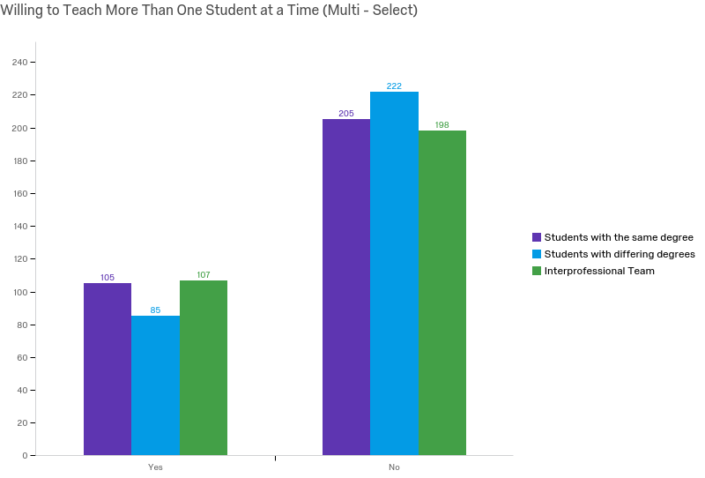

Slide 15
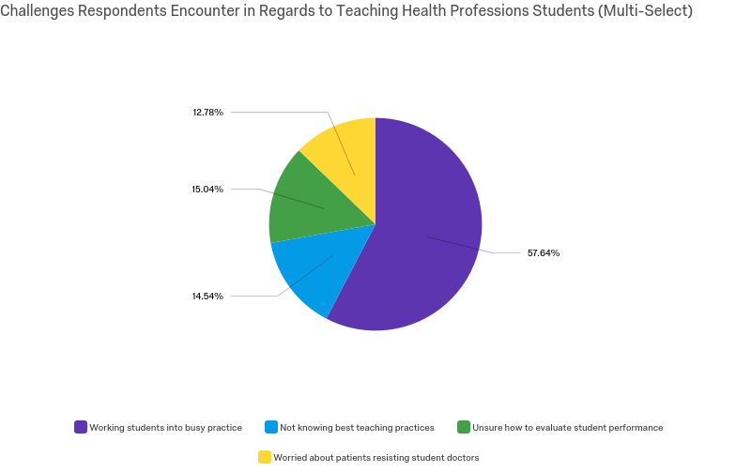

Slide 16
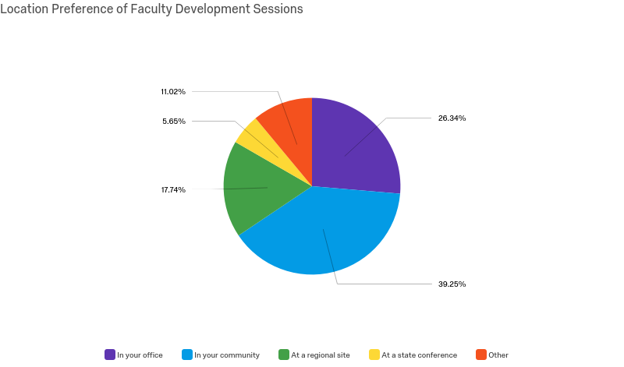

Slide 17
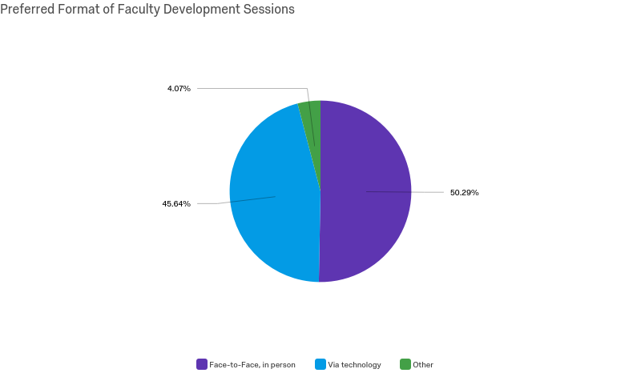

Slide 18
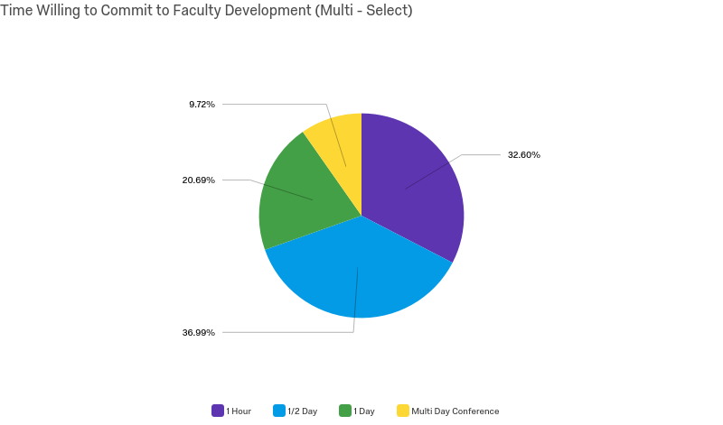

Slide 19
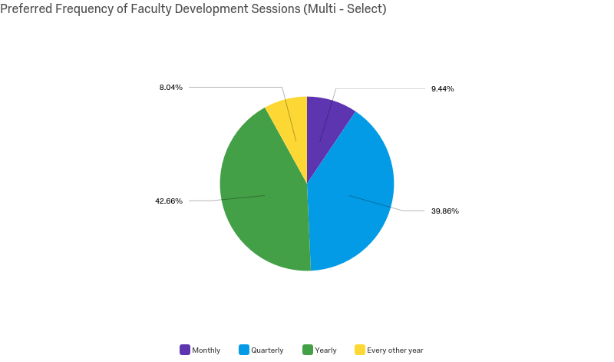

Slide 20
